Slide 1

Sole Trader
This Photo by Unknown Author is licensed under CC BY

Slide 2
Are you a sole trader?
If you run your own personal business, or earn income outside of an employment relationship, you may be considered a sole trader.

Slide 3
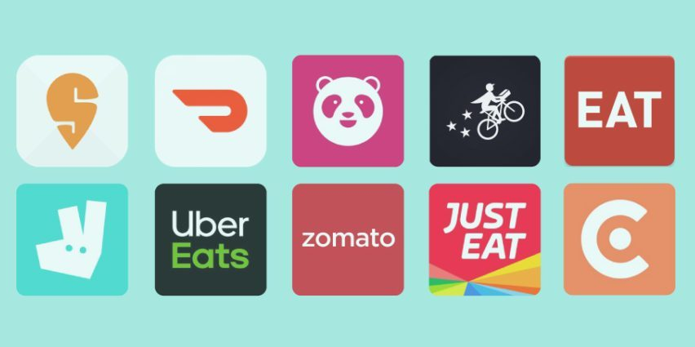
Examples
For example, if you earn income through Uber or other apps, you are likely a sole trader.
Other examples include tutoring, or teaching guitar, etc.

Slide 4
Tax Considerations
As a sole trader, you must consider:
Whether you receive Personal Services Income
Working out if the PSI rules apply to you
Deductions
Record-keeping

Slide 5
Personal Service Income (PSI)

Slide 6
What is PSI?
Personal services income or PSI is income that is mainly a reward for an individual's personal efforts or skills,
Almost any industry can generate PSI.
Some of the most common examples are:
Financial professionals, such as accountants, bookkeepers, and tax agents
IT Consultants
Trades workers, such as plumbers, electricians, and carpenters
Medical Practitioners, such as dentists, doctors, and chiropractors

Slide 7
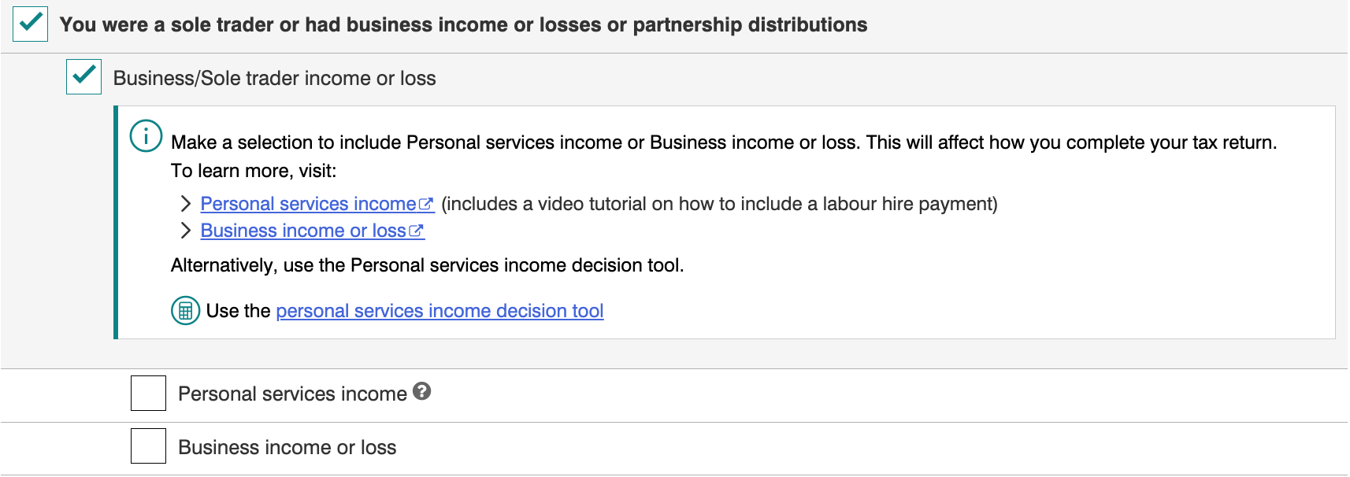
PSI or business income?
If you have earned PSI and the PSI rules apply to you, you must declare this income as Personal services income in your tax return.
If you have earned PSI and the PSI rules do not apply to you (meaning that you are considered a Personal Services Business), declare this income as Business income or loss in your tax return.
​

Slide 8
Do you receive PSI?
If more than 50% of the income from a contract was for your labour, skills or expertise, you are receiving PSI.
If so, continue to the next step to determine if the PSI rules apply to you.
If not, this presentation might not be applicable to you. However, going through test on the next slide may help you understand PSI better.

Slide 9
Do the PSI rules apply to you?
(Results test)
If you meet all of the following conditions for at least 75% of your PSI, you pass the results test:
You are paid to produce a specific result.
You are required to provide the equipment and tools.
You must fix any mistakes at your own cost.
If you pass this test, your business is a Personal Services Business(PSB) and the PSI rules don't apply to the income you earn from this PSB.
If you do not pass this test, proceed to the next step.

Slide 10
Do the PSI rules apply to you?
(80% Rule)
Does more than 80% of the PSI come from one client?
If yes, the PSI rules apply.
If not, you have met the 80% rule. Proceed to the next step.
The client could be an entity or its associates. If you have unusual circumstances, you can apply for a PSB determination.

Slide 11
Do the PSI rules apply to you?
(Unrelated clients test)
Remaining Tests for PSB assessment
You will pass the unrelated clients test if you meet both of the following conditions:
You have received PSI from two or more unrelated clients.
The work must have been offered to the public (e.g., through advertising).
If you pass this test, your business is a Personal Services Business(PSB) and the PSI rules don't apply.
If not, proceed to the next step.

Slide 12
Do the PSI rules apply to you?
(Employment test)
Remaining Tests for PSB assessment
You will pass the employment test if your business meets one of the following conditions:
You have subcontractors who perform at least 20% of the principal work.
You have employed one or more apprentices for half the income year.
If you pass this test, your business is a Personal Services Business(PSB) and the PSI rules don't apply.
If not, proceed to the next step.

Slide 13
Do the PSI rules apply to you?
(Business premises test)
You will pass the business premises test if at all times in the income year you maintained and used a business premises which meets all of the following conditions:
used mainly to gain or produce PSI
used exclusively by you
physically separate from your private premises
physically separate from your clients' premises
If you pass this test, your business is a Personal Services Business(PSB) and the PSI rules don't apply.
The PSI rules apply to you.

Slide 14
Tax obligation for sole traders that pass the PSB tests
If you received PSI but found that the rules do not apply, there are no changes to the deductions you can claim against the income.
You can claim a tax deduction for most expenses you incur in carrying on your business if they are directly related to earning your assessable income.

Slide 15
Tax obligation for sole traders that do not pass the PSB tests
If you earn PSI and the PSI rules apply to that income, the types of deductions you can claim may be affected.
The following deductions cannot be claimed against the PSI:
Rent, mortgage interest, rates or land tax for your homes
Payments to associates for non-principal work
Super contributions for associates for non-principal work
Other expenses not generally entitled to employees
In general, when you earn PSI you are treated as though you are in the same position as an employee.

Slide 16
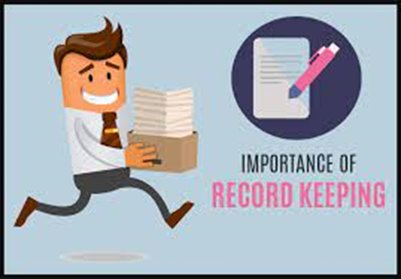
Recording Keeping
For most expenses you need a receipt or similar document from the supplier that shows all of the following:
-the name or business name of the supplier
-the amount of the expense or cost of the asset
-the nature of the goods or services that you purchase
-the date you purchase the goods or services(must be within the financial year)
-the date the document was produced.
-they must be in English where you incur the expense in Australia.
All records must be retained for 5 years after you lodge the relevant tax return.

Slide 17
Deductions
Work-related Car expenses (cars under 1 tonne)

Slide 18
Deductions
If you own or lease a car, you can use either of 2 methods to calculate deductions for car expenses:
Cents/kilometre
Total business kilometres traveled multiplied by $0.88 equals total deductions
The rate covers all car expenses, including depreciation
Maximum claim is $0.88 x 5000km
Logbook
Keep a continuous record for 12 weeks of total kilometres traveled
Calculate your work-related use percentage by dividing work kilometres by total kilometres
Multiply this percentage by total car expenses to determine deductions
With this method, you calculate depreciation separately.

Slide 19
Deductions
Using a vehicle that isn't yours
To claim a deduction that does not belong to you or is not a car, you:
work out your actual expenses for your work-related travel in the vehicle
claim the deduction in your tax return as a work-related travel expense (not as a work-related car expense).
You can't use the cents per kilometre method or the logbook method to work out your claim. However, as you can only claim a deduction for the expenses related to your work-related travel, you may wish to keep a document similar to a logbook to calculate your work-related use percentage.

Slide 20
No Petrol Receipt?
Step 1
Step 2
Step 3
Fuel Consumption from:
Green Vehicle Guide
Fuel Price from:
AIP Annual Retail Price Data
Total km travelled x fuel consumption (eg 10lts)/100 x fuel price per litre
Notes:
Update the link

Slide 21
Take Note….
If the car is salary packaged, motor vehicle expense can’t be deducted. You can claim additional out-of-pocket expenses, such as parking and tolls associated with your work use.
A purchase invoice is required to calculate depreciation for a vehicle you own.

Slide 22
ANU Tax Clinic
We are available from Wednesday to Friday 12pm to 2pm.
To book your appointment you can fill up the enquiry form at our website, reach out to us directly at taxclinic@anu.edu.au or call us on 02 6125 4853.

Slide 23


Book a Free Consultation
For eligibility criteria and bookings, visit
»» rsa.anu.edu.au/anu-tax-clinic
For any enquiries contact us at
»» taxclinic@anu.edu.au
Or call us on
»» 02 6125 4853
Notes:
If you need further tax information, you can make an appointment.

