Slide 1

Personal Services Income

Slide 2
Personal Services Income
Personal services income (PSI) is income that is mainly a reward for an individual's personal efforts or skills.​
There are special tax rules around PSI to improve the integrity and equity of the tax system. The rules prevent people from reducing or deferring their income tax by diverting income they've received from their personal services through companies, partnerships or trusts.​
Income is classified as PSI when more than 50% of the income you've received is a reward for your personal efforts and skills, rather than being generated by the use of assets, the sale of goods or by a business structure.

Slide 3
EXAMPLES OF PSI
If you’re operating as a sole trader and you are hired on a contract basis to provide a training course to a group of people, it’s possible you’re earning PSI. If you charge $200 for the training course, and $50 of that is to cover the textbook, then you’ve earned 75% of your income for your skills and expertise. Thus, the full $200 for the course is considered to be PSI income.
​
Common examples of when income is not PSI is where 50% or more is generated from: ​
Your salary or wages – however, if you earn PSI indirectly through another entity this can still be classified as PSI​
Supplying or selling goods​
Supplying or using an income-producing asset​
Income from a business structure

Slide 4
EXAMPLES OF PSI
You can receive PSI in almost any industry, trade or profession. However, some common examples include:
​
Financial professionals​
Information technology consultants​
Engineers​
Construction workers​
Medical practitioners

Slide 5
$
PSI or Business income?

Slide 6
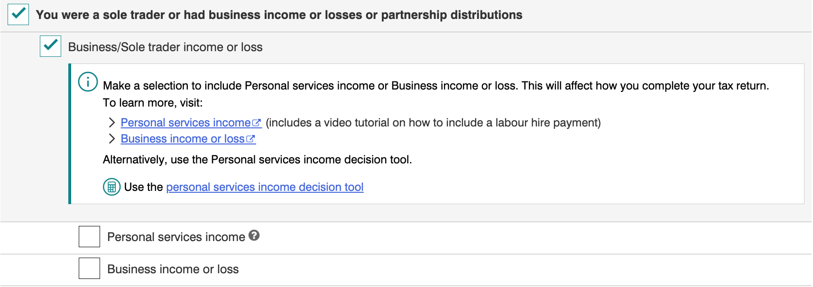
PSI or business income?
If you have earned PSI and the PSI rules apply to you, you must declare this income as Personal services income in your tax return.
If you have earned PSI and the PSI rules do not apply to you (your business is a Personal Services Business), declare this income as Business income or loss in your tax return.
​

Slide 7
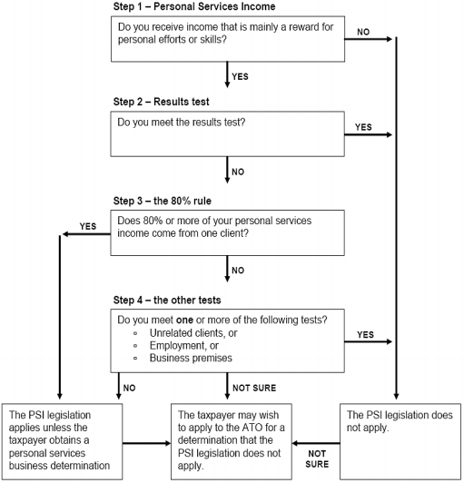
Personal services entity (psb) determination flow chart

Slide 8
SELF-ASSESSING AS A PSB
To self-assess as a PSB, you must either:​
​
a) Meet the results test in relation to at least 75% of your PSI; or​
b) Meet one of the other PSB tests and less than 80% of your PSI is from the same entity and its associates. The other PSB tests are:​
i) Unrelated clients test​
ii) Employment test​
iii) Business premises test​
​
If you do not satisfy either a) or b) but you are still earning more than 50% of your income from your skills and expertise, you will be earning PSI but you will not be able to self-assess as a PSB.

Slide 9
THE RESULTS TEST
To pass the results test, you need to meet all 3 of the following conditions for at least 75% of your PSI you earnt:​
You must be paid to produce a specific result
You are required to provide equipment or tools (if required)​
You are required to fix mistakes at your own cost ​
Generally, you are paid to produce a specific result when:​
Payment is made after contractual conditions have been fulfilled
Being paid an amount for an agreed number of completed items or activities ​
To meet the ‘required to fix mistakes at your own cost’ condition, you must be liable for the cost of rectifying any defects in your work. You do not need to actually perform the work that fixes the mistake, so long as you are liable.

Slide 10
THE 80% RULE
Whether or not the 80% rule is satisfied might lead to a different result in terms of whether the PSI rules will apply or whether you will need to self-assess as a PSB:​
​If 80% or more of your PSI comes from one client and their associates, you do not meet the 80% rule. The PSI rules will apply.​
If less than 80% of your PSI comes from one client and their associates you do meet the 80% rule. If you also meet one of the unrelated clients, employment, or business premises tests, you can self-assess as a PSB.

Slide 11
UNRELATED CLIENTS TEST
To pass the unrelated clients test in an income year, you must meet both of the following conditions:​
You must have received PSI from 2 or more unrelated clients
There must be a direct connection between the offer to the public and you being engaged to perform the work​
If you operate through a company, partnership, or trust and you have more than one individual generating PSI, you’ll need to work out whether you pass the unrelated clients test for each individual separately.

Slide 12
EMPLOYMENT TEST
To pass the employment test, your business must employ or contract others to help perform work that generates your PSI, and you must meet one of the following conditions:​
At least 20% of the principal work is performed by others
One or more apprentices are employed for at least 6 months of the income year

Slide 13
BUSINESS PREMISES TEST
You will pass the business premises test if at all times in the income year you maintained and used a business premises which meets all of the following conditions:​
Used mainly to gain or produce PSI​
Used exclusively by you​
Physically separate from your private premises​
Physically separate from your clients’ premises

Slide 14
If you received PSI and found that the rules apply
Deduction not Allowed
Rent, mortgage interest, rates or land tax for your homes
Payments to associates for non-principal work
Super contributions for associates for non-principal work
Other expenses not generally entitled to employees

Slide 15
PERSONAL SERVICES BUSINESS (PSB)
Criteria for qualifying as a PSB：
You must either meet the results test, or meet another PSB test and pass the 80% rule.
Do you have a turnover of more than $75,000?
If your business has a turnover of more than $75,000, you are required to register for GST and lodge Business Activity Statements.
All ride-sourcing (e.g., UberX) and taxi drivers must register for GST and lodge BAS statements, irrespective of their business turnover.
What you can claim as Business Deduction
Day-to-day operating expenses
Purchases of products or services for your business
Certain capital expenses, such as the cost of depreciating assets like machinery and equipment used in your business.

Slide 16
PSI Rules Self-Assessment: A Step-by-Step Walkthrough
Follow the journey of two cleaners, Alex and Sam. Who runs a true business?
Alex: The Integrated Worker
• He is paid by the hour for his time and effort, not for a defined outcome.
• He relies on one firm for most income.
• The client firm provides all cleaning equipment, supplies, and products.
• He is paid by the hour for his time and effort, not for a defined outcome.
Sam: The Independent Business
• He advertises online to seek diverse clients.
• He purchased his own commercial-grade vacuum, cleaning tools, and a car for transport.
• He is paid a fixed price to leave a premises in a clean state. If a client is unhappy, Sam must return and correct the work at his own expense.

Slide 17
ALEX • He is paid by the hour for his time and effort, not for a defined outcome. • He relies on one firm for most income. • The client firm provides all cleaning equipment, supplies, and products. • He is paid by the hour for his time and effort, not for a defined outcome.
Step 1: Receive Personal Services Income? YES ✅
Step 2: Satisfy the Results Test? NO❌
paid to produce a specific result ❎
required to provide the equipment or tools ❎
required to have mistakes fixed at your own expense ❎
Step 3: Satisfy the 80% rule?YES ✅
The PSI rules apply. ALEX has limitation on deductions.

Slide 18
Sam • He advertises online to seek diverse clients. • He purchased his own commercial-grade vacuum, cleaning tools, and a car for transport. • He is paid a fixed price to leave a premises in a clean state. If a client is unhappy, Sam must return and correct the work at his own expense.
Step 1: Receive Personal Services Income? YES ✅
Step 2: Satisfy the Results Test? YES ✅
paid to produce a specific result ✅
required to provide the equipment or tools✅
required to have mistakes fixed at your own expense ✅
The PSI rules do not apply. Sam can claim a tax deduction for most expenses you incur in carrying on your business if they are directly related to earning your assessable income.

Slide 19


Book a Free Consultation
For eligibility criteria and bookings, visit
»» rsa.anu.edu.au/anu-tax-clinic
For any enquiries contact us at
»» taxclinic@anu.edu.au
Or call us on
»» 02 6125 4853
Notes:
If you need further tax information, you can make an appointment.

