Slide 1
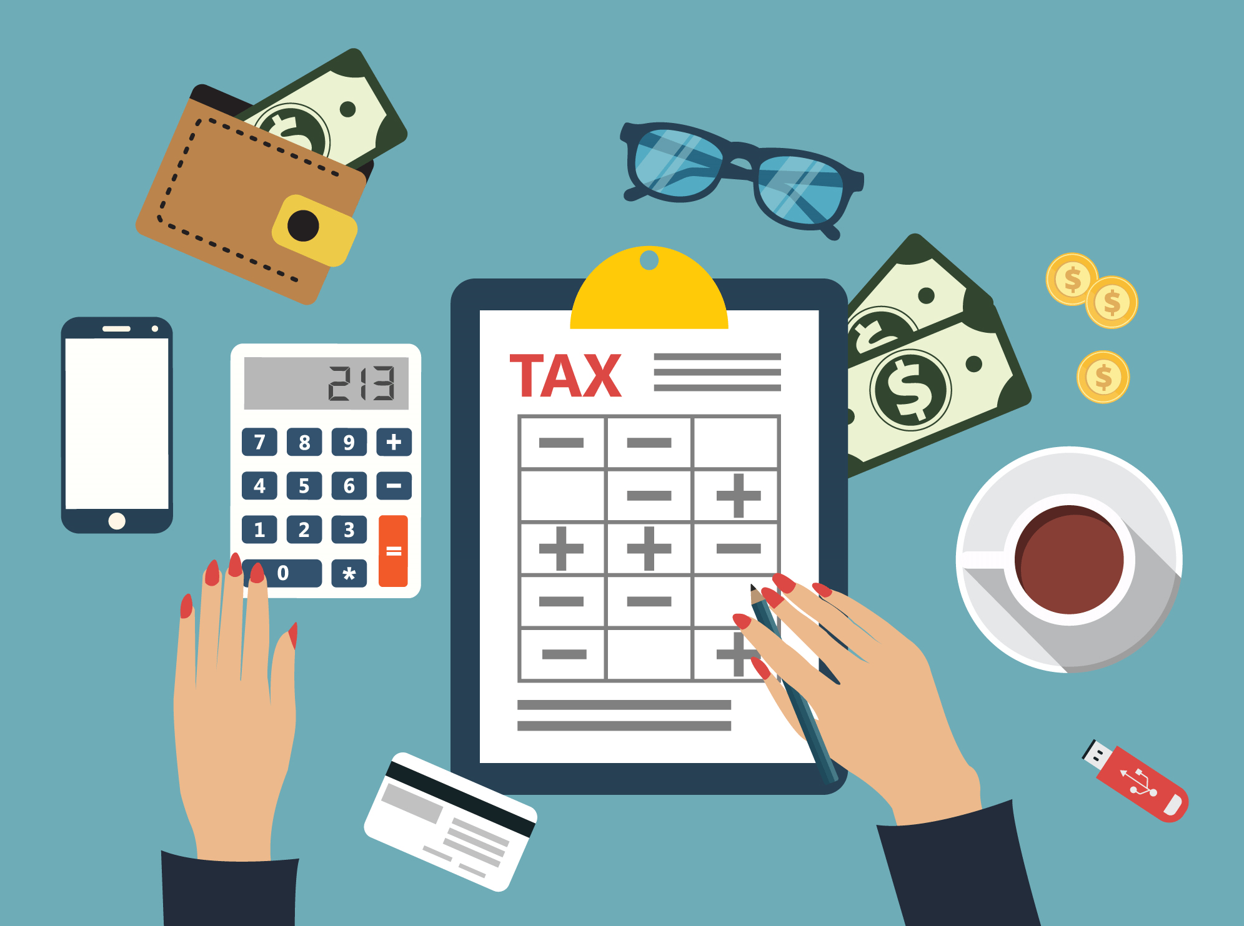

myGov Walkthough

Slide 2
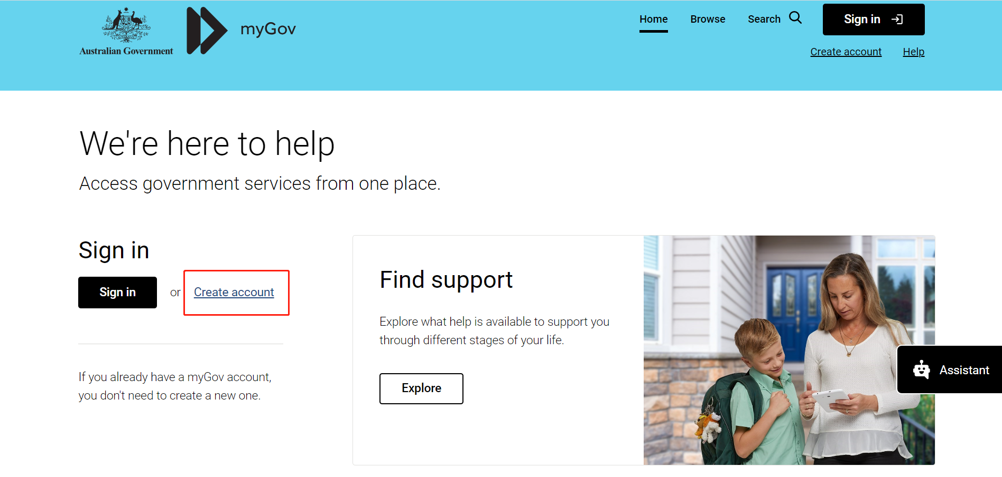
How to create your account?
Click this link to set up your account
https://my.gov.au/
Click ‘Create account’

Slide 3
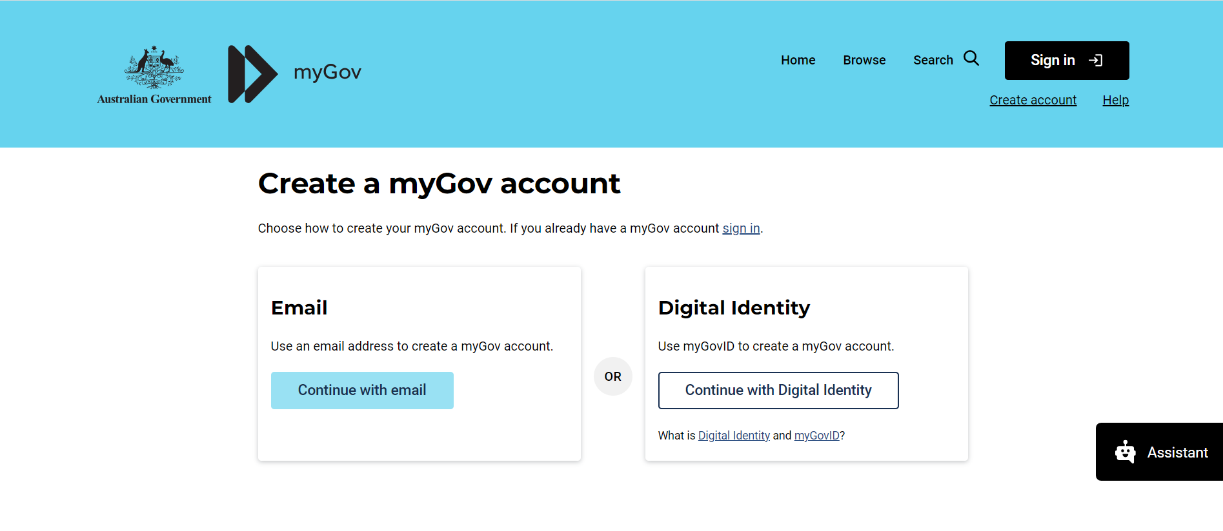
You have the option to create an account either through your email or by using a digital identity.

Slide 4
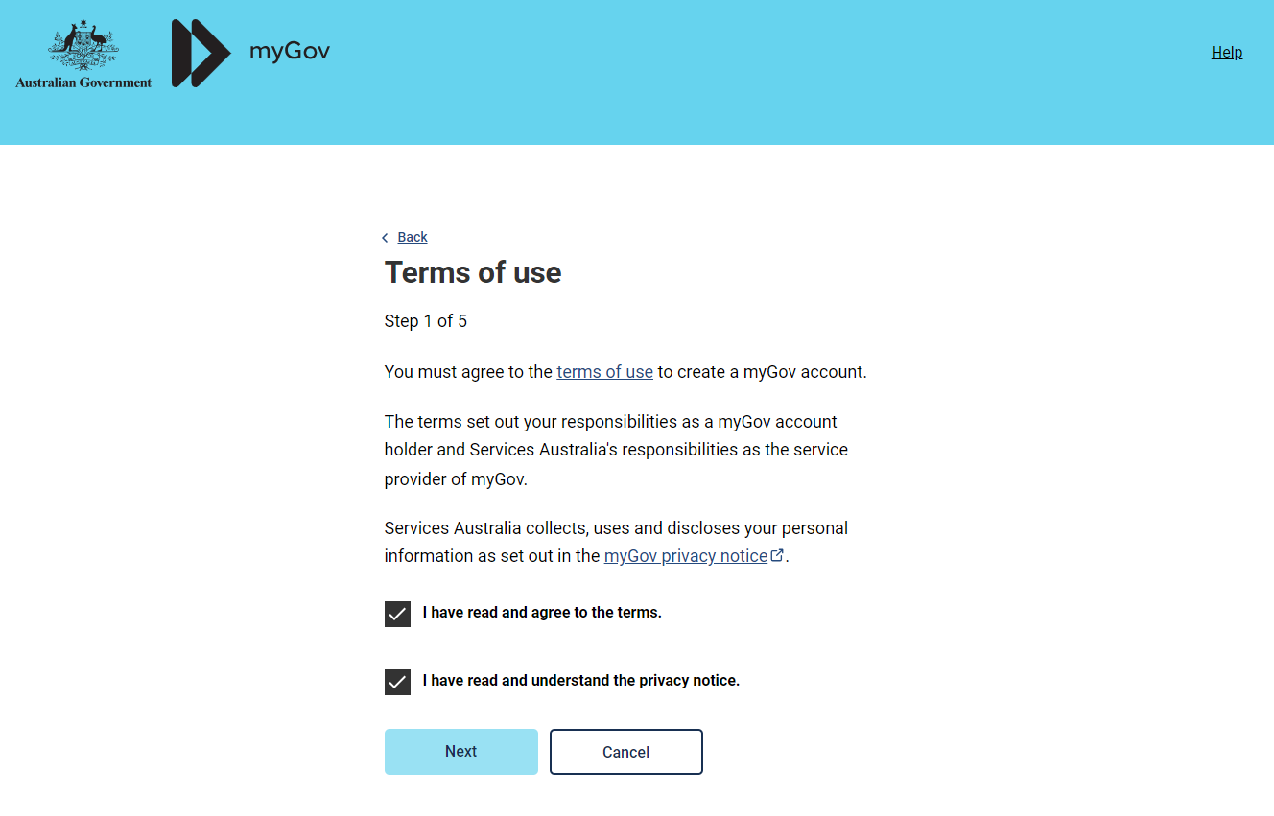
Step 1:
Agree with the terms of use.

Slide 5
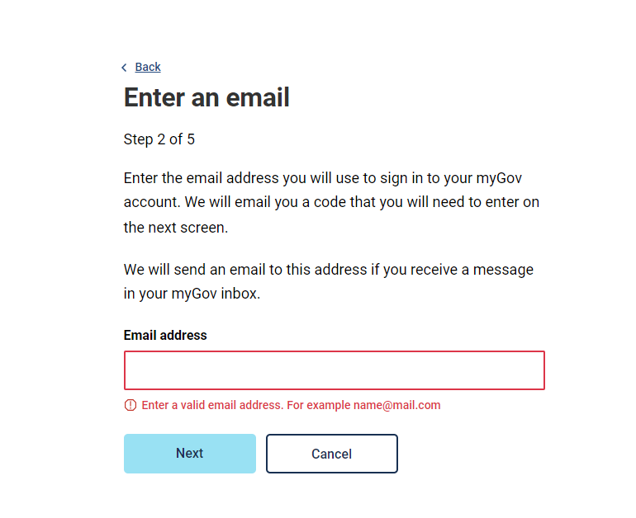
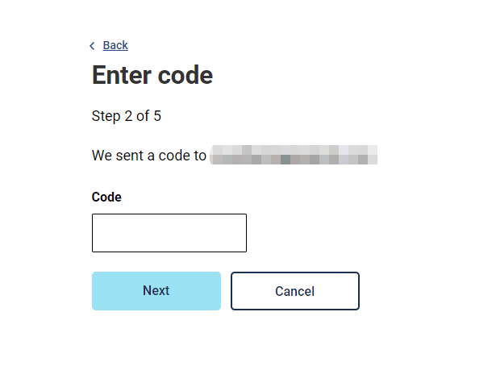
Step 2:
Enter your email address and received code.

Slide 6
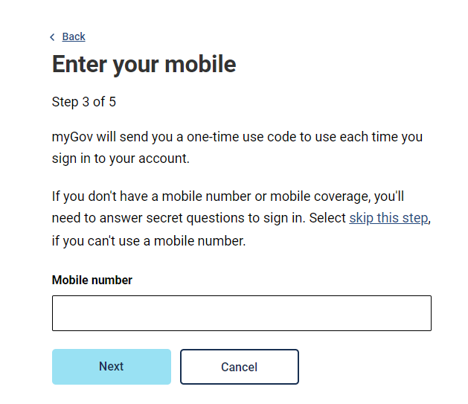
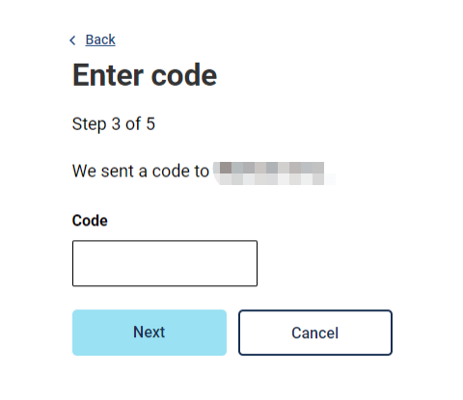
Step 3:
Enter your phone number and received code.

Slide 7
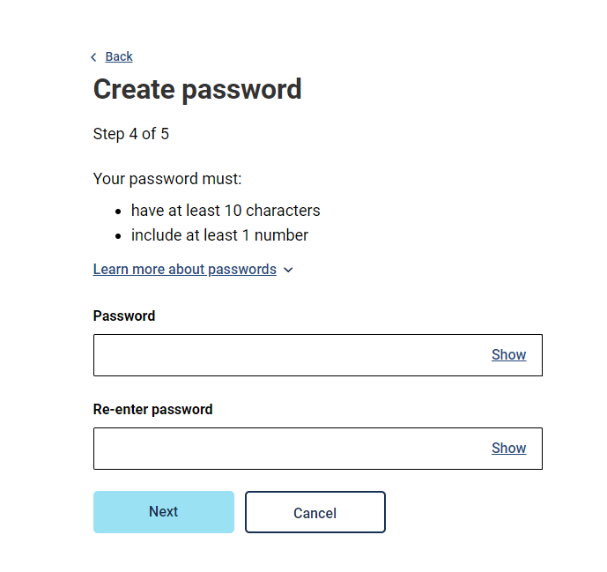
Step 4:
Create your password.

Slide 8
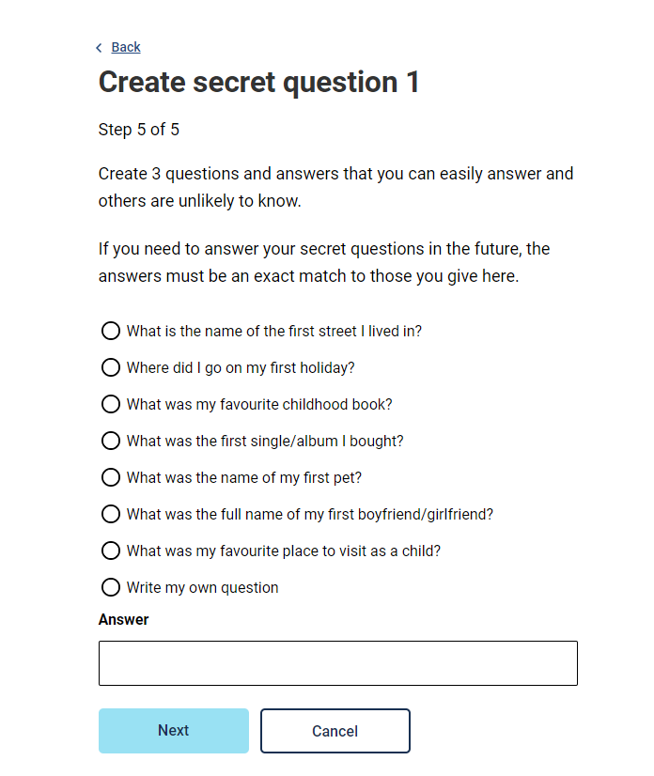
Step 5:
Please create 3 secret questions.
Please make sure to remember them.
If you forget these questions, you‘ll need to create a new account.

Slide 9
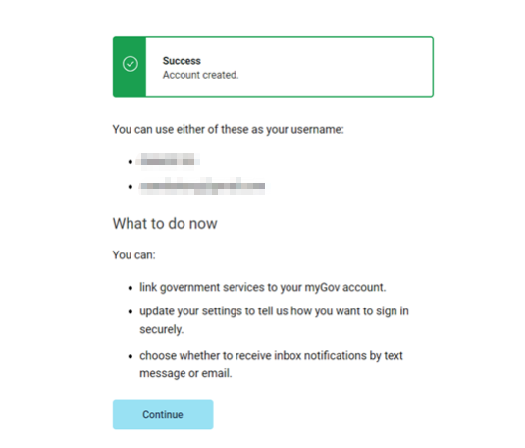
Success!
Wonderful news!
You've successfully accessed your myGov account.
The next step involves linking your myGov account to the ATO (Australian Taxation Office).

Slide 10
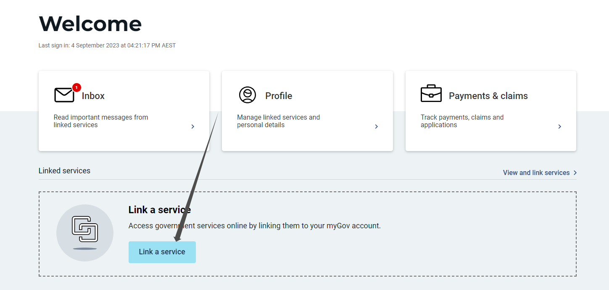
How to link it to ato?
Step 1:
Navigate to your myGov Account Page and click the 'Link a service' button.

Slide 11
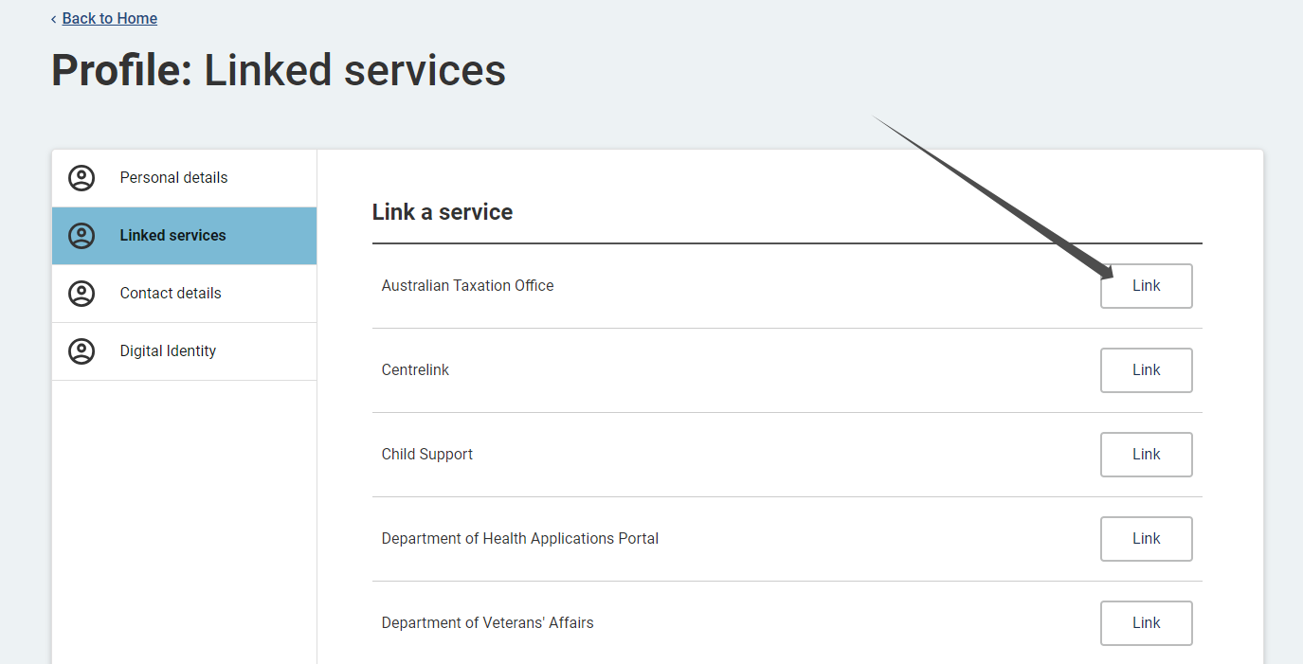
Step 2:
Upon clicking the button, you will encounter various options. Select 'Australian Taxation Office' to link your account.

Slide 12
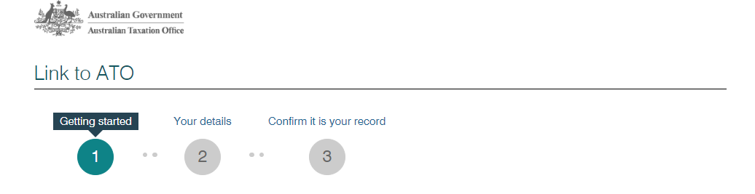
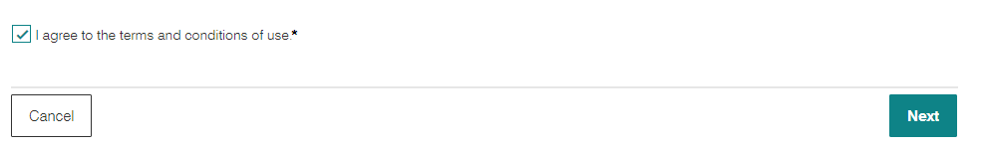
Here is showing the subsequent procedure:
Step 3: Scroll to the bottom of the page and click the "Agree" button.

Slide 13
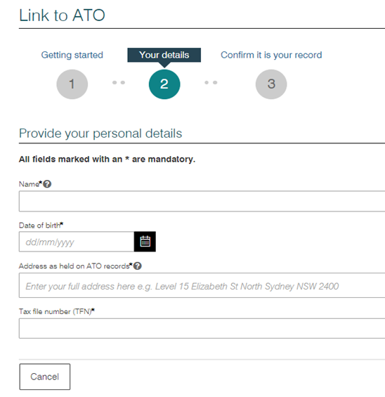
Step 4:
Entering your personal information.

Slide 14
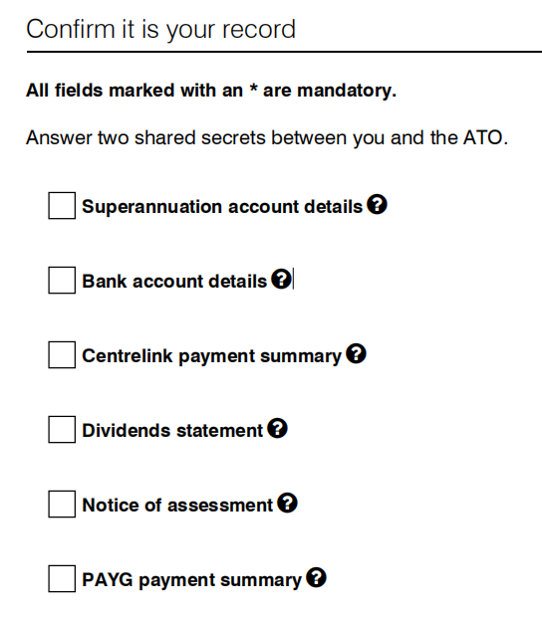
Step 5
Select two of the following options to confirm it is your record.

Slide 15
Additional
If you encounter issues with manual linking, or currently you do not have the above records, you may need to contact the ATO at 132 861 to request a linking code.
You should file your tax return after 30th June, but be sure to submit it before 31st October. If you have a tax agent, you'll have an extended timeframe.

Slide 16
ANU Tax clinic
We are available from Wednesday to Friday 11.30am to 2pm.
To book your appointment you can fill up the enquiry form at our website, reach out to us directly at taxclinic@anu.edu.au or call us on 02 6125 4853.

